Slide 1
ONLINE CHAT APPLICATION
T.Ajaykumar.

Slide 2
INTRODUCTION:
Teleconferencing or Chatting, is a method of using technology to
bring people and ideas “together” despite of the geographical
barriers.
The technology has been available for years but the acceptance it
was quit recent. Our project is an example of a chat server.
It is made up of 2 applications the client application, which runs
on the user’s Pc and server application, which runs on any Pc on the
network.
To start chatting client should get connected to server where they
can practice two kinds of chatting, public one (message is
broadcasted to all connected users) and private one (between any 2
users only) and during the last one security measures were taken.

Slide 3
PROBLEM STATEMENT:
The chat application has been developed to override the problem prevailing in the practicing manual system.
This software is supported to eliminate and in some cases reduce the hardships faced by this existing system.
Moreover this system is designed for the particular need of the company to carryout operations in a smooth and affective manner.

Slide 4
SCOPE OF THE PROJECT
This project is to create a chat application with a server and clients to enable the clients to chat with many other clients in the same common chat group.
This project is to simulate the multicast chatting. In the case of multicasting when a message is sent to a group of clients, then only a single message issent to the router.
The main purpose of this project is to provide multichatting functionality through network.

Slide 5
HARDWARE REQUIRMENTS:
RAM- minimum 128 MB
Hard disk—minimum 5 GB
Processor- Pentium 3
Floppy drive 1.44” inch CD drive

Slide 6
SOFTWARE REQUIRMENTS:
Operating system—Windows 7
Others—Visual Studio, AWS

Slide 7
FUNCTIONALITIES PROVIDED:
1. To increase the efficiency of managing the chat profile and chat user.
2. Managing the information of group chat.
3. Chat application also manages multi chat online for group chat details.
4. It tracks all the information of chat user, group chat.

Slide 8
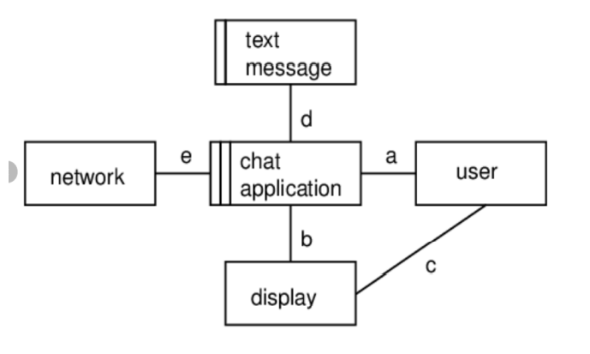
CAMPUS DIAGRAM OF CHAT APPLICATION:

Slide 9
MODULES OF THE APPLICATION:
This application is designed into five (3) independent modules which take care of different tasks efficiently.
1. User Interface Module.
2. Server Module.
3. Multi user Module.

Slide 10
USER INTERFACE MODULE
Actually every application has one user interface for accessing the entire application.
The user interface for the Packet sniffer application is designed completely based on the end users. It provides an easy to use interface to the users.
This user interface has an attractive look and provides ease of navigation. Technically, the swing is used in core java for preparing this user interface.

Slide 11
SERVER MODULE:
Most popular Web servers are modular pieces of software, which means they can be customized by loading the Web server module for a particular function.
Most people use Apache with Linux or Windows, and both Apache and Linux are modular components of a server stack.

Slide 12
MULTI USER MODULE
More than a single user is permitted use the application without any server issues.
Whenever a new user is added to the network then the rest of the users will be notified with a message of connected will be popped up on the screen.
And as well as they leave the network the rest users will be notified with a disconnected message from the network.

Slide 13
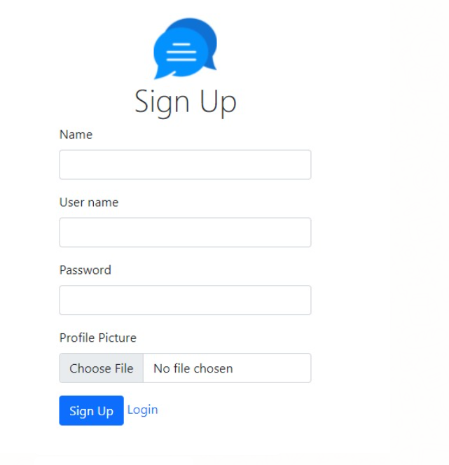
USER INTERFACE – SIGNUP PAGE

Slide 14
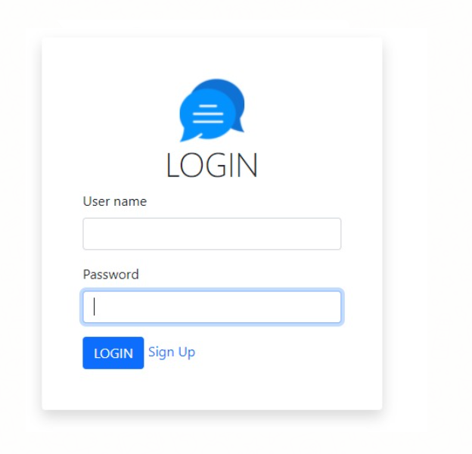
USER INTERFACE – LOGIN PAGE

Slide 15
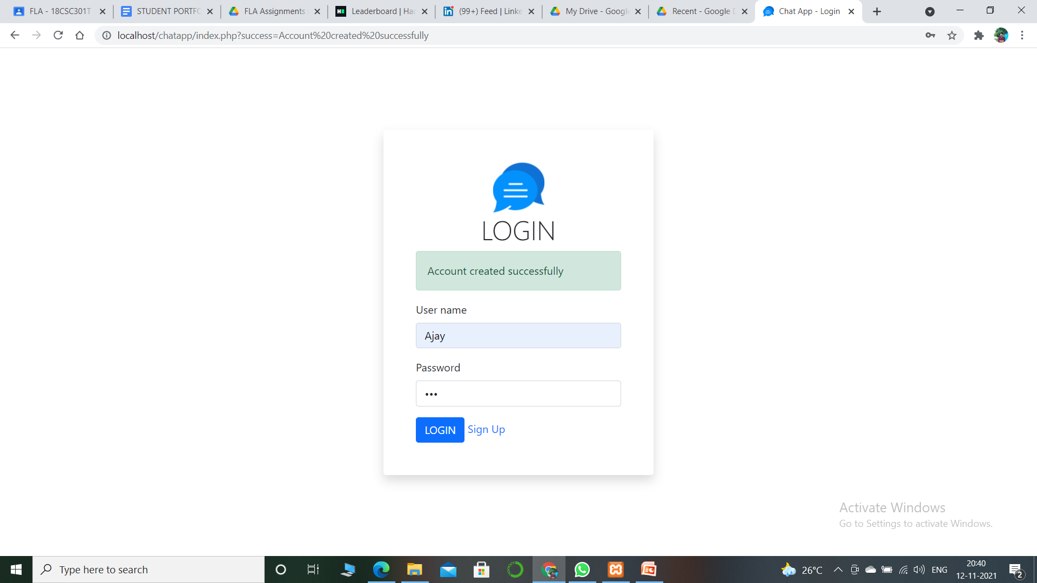
After creating an Account

Slide 16
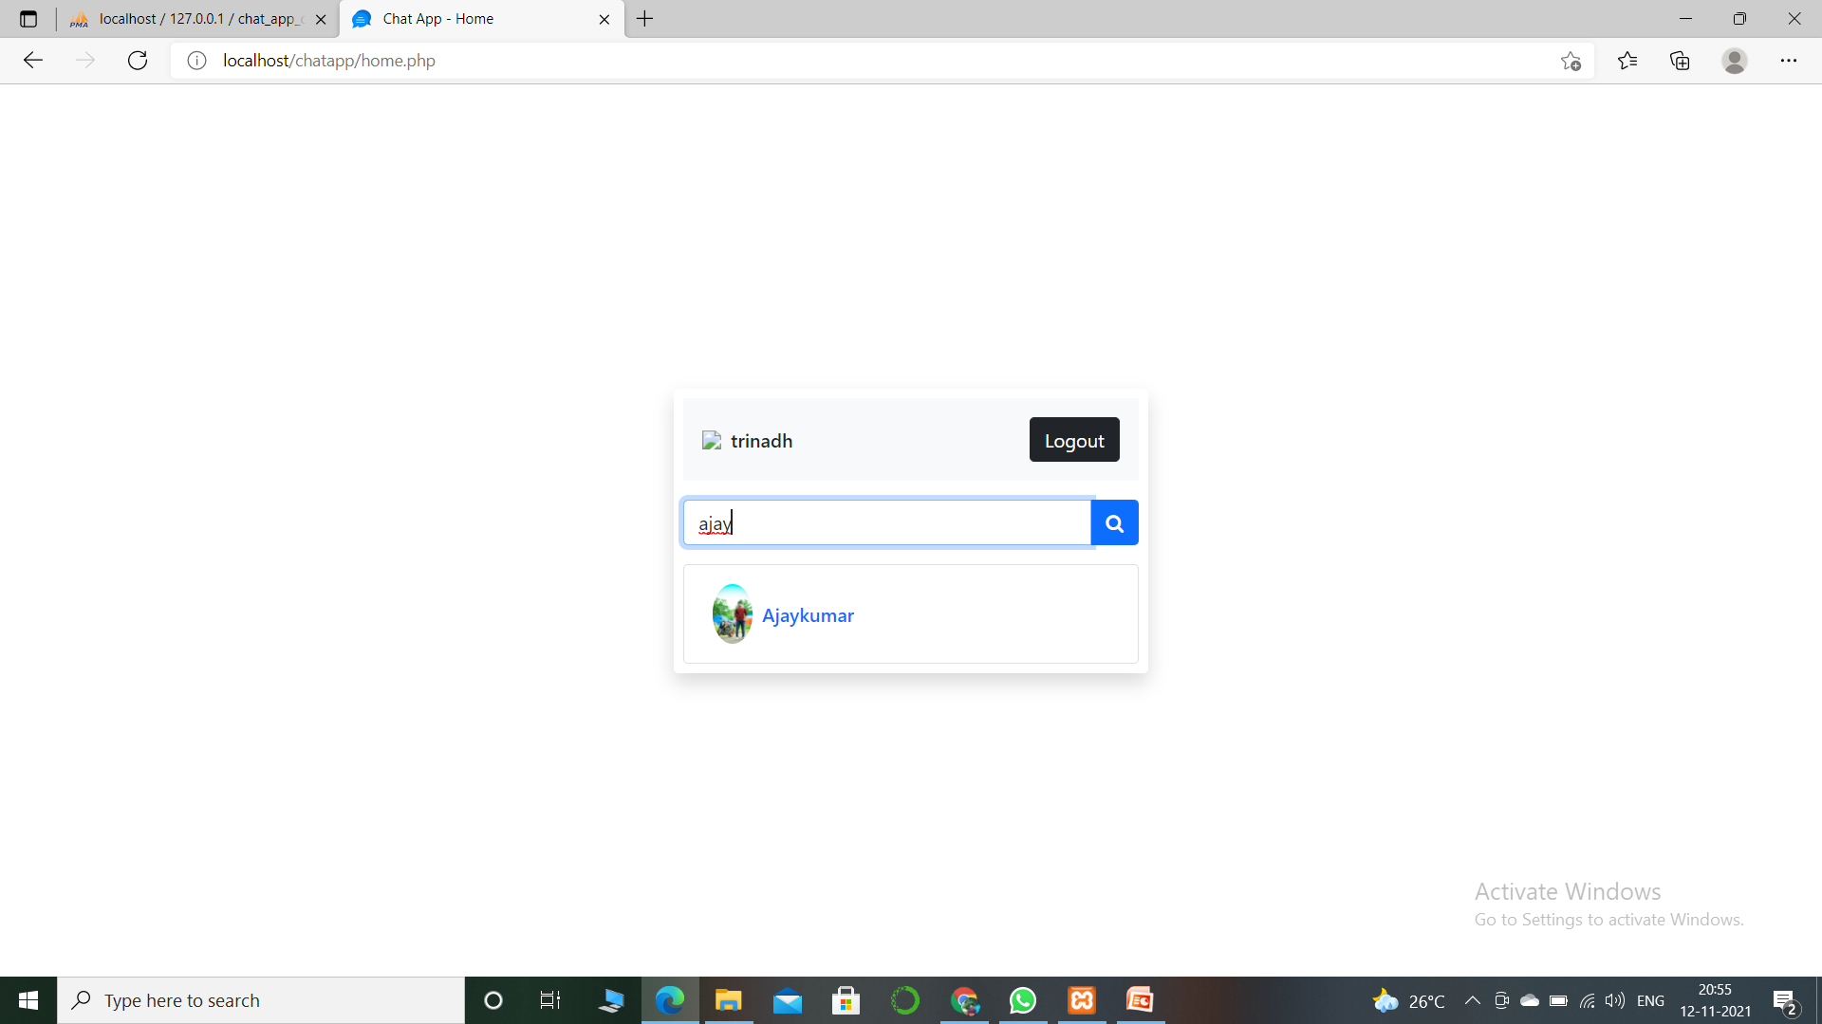
RECENT CHATS

Slide 17
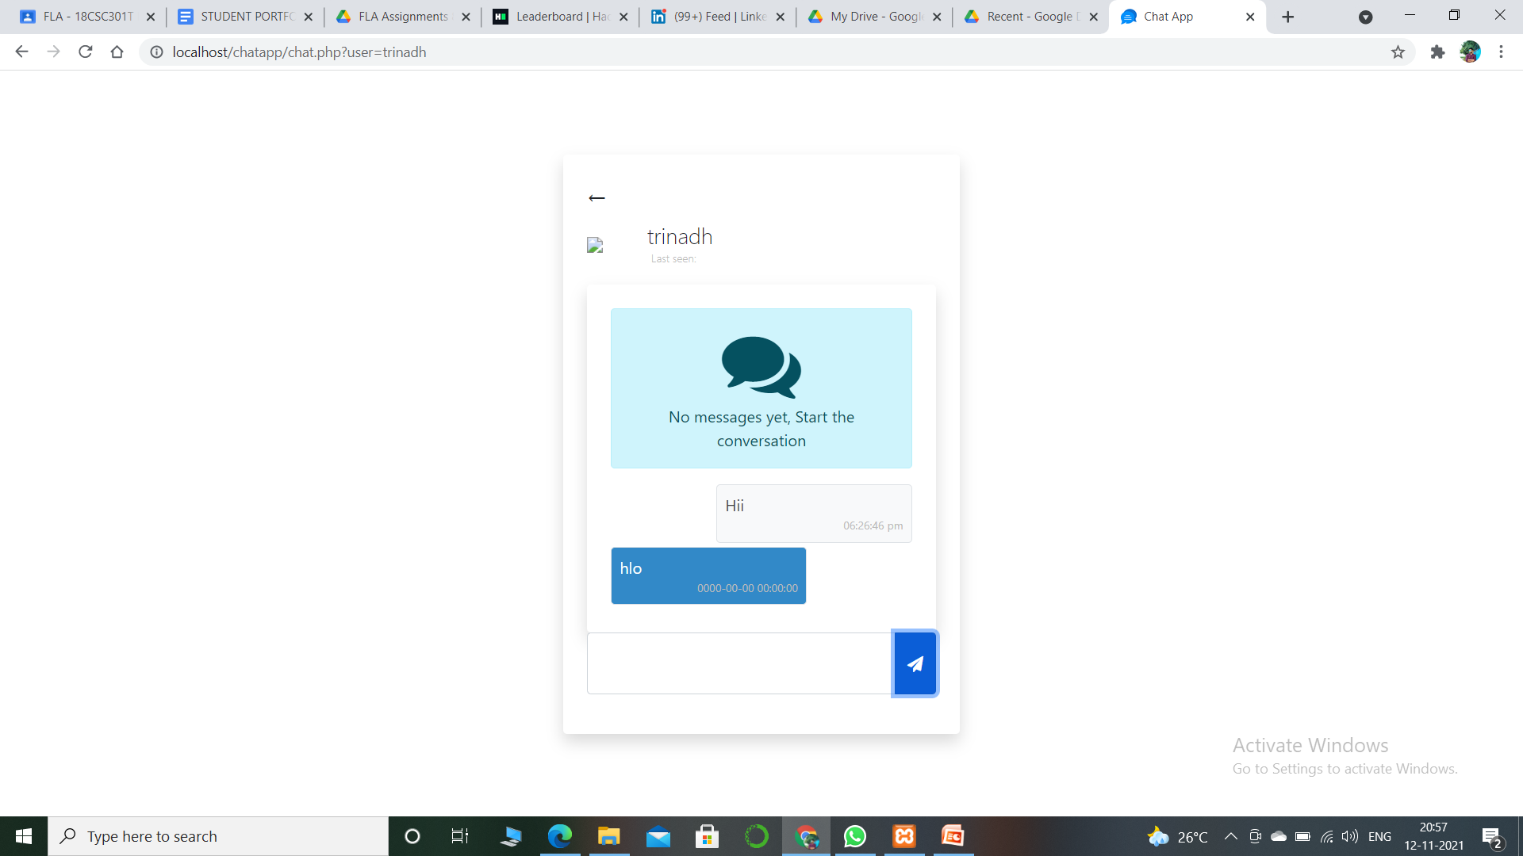
Conversation

Slide 18
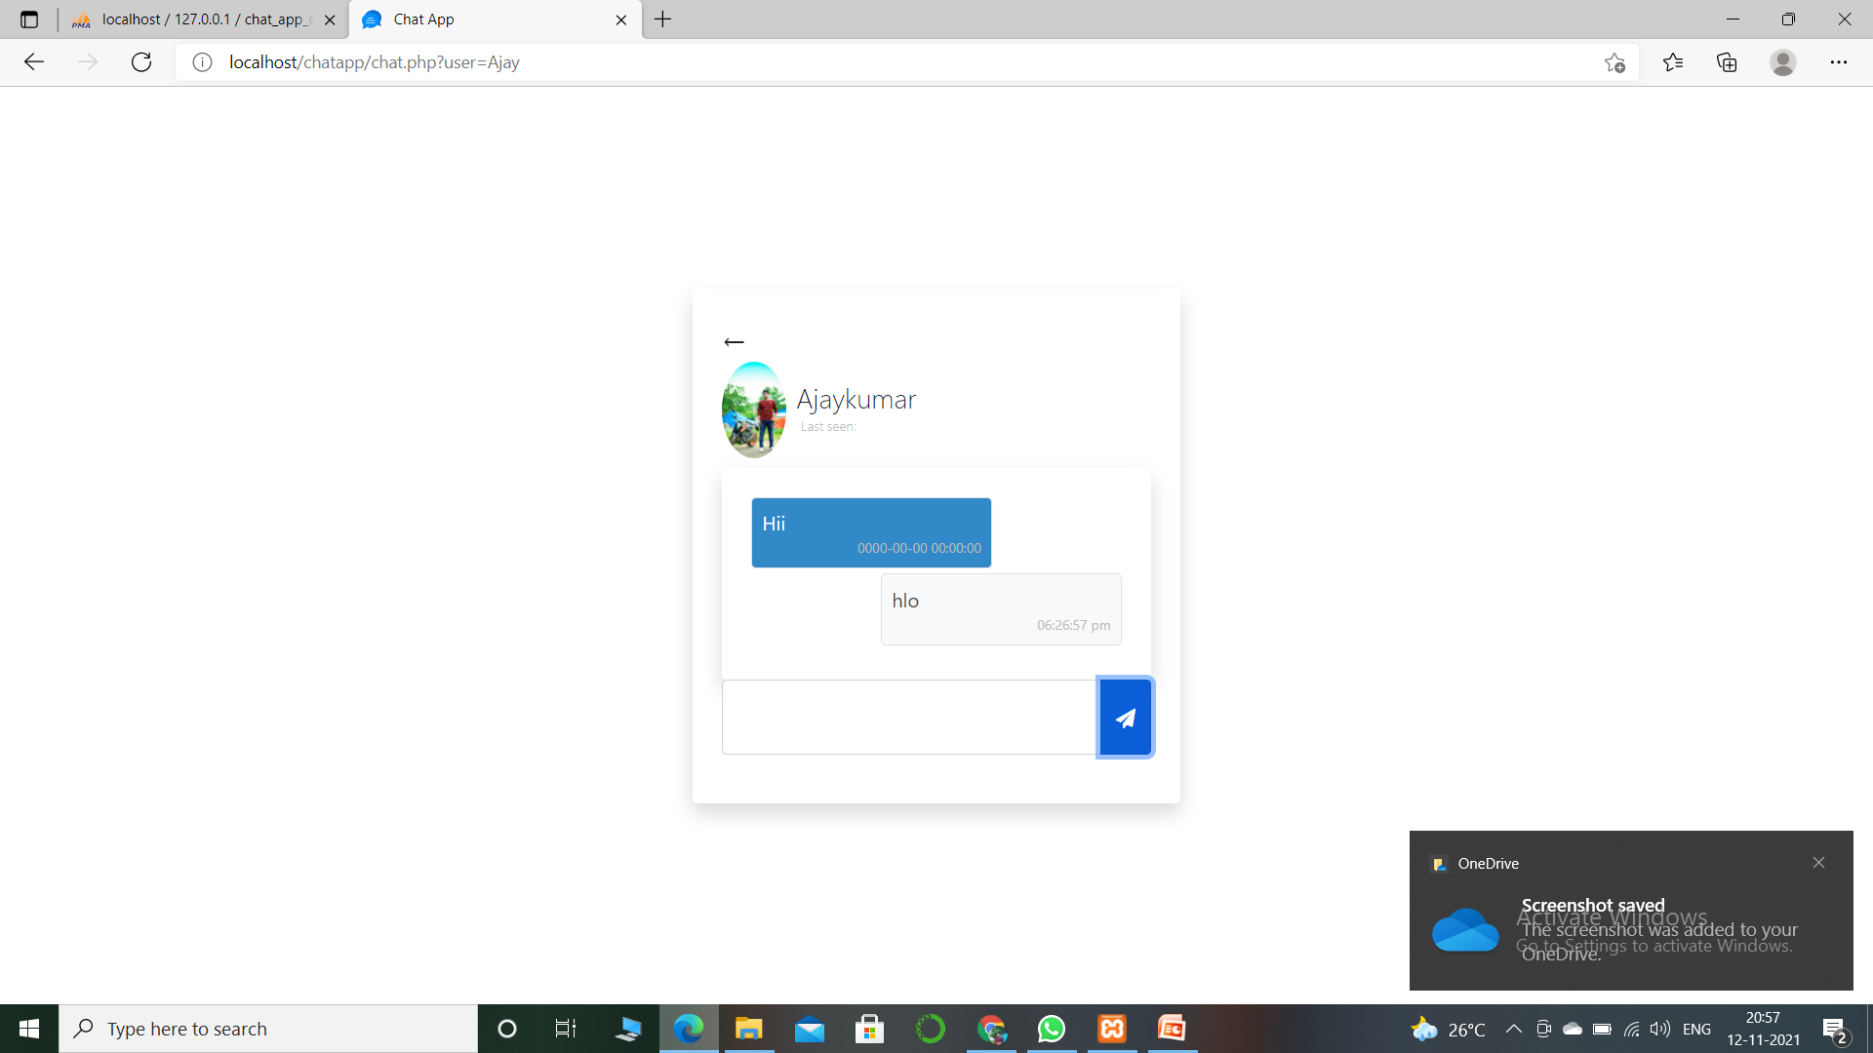

Slide 19
The data of user is stored in Data base. If the user gives the wrong details like user name or password they may not able to login. They will get the blank page.

Slide 20
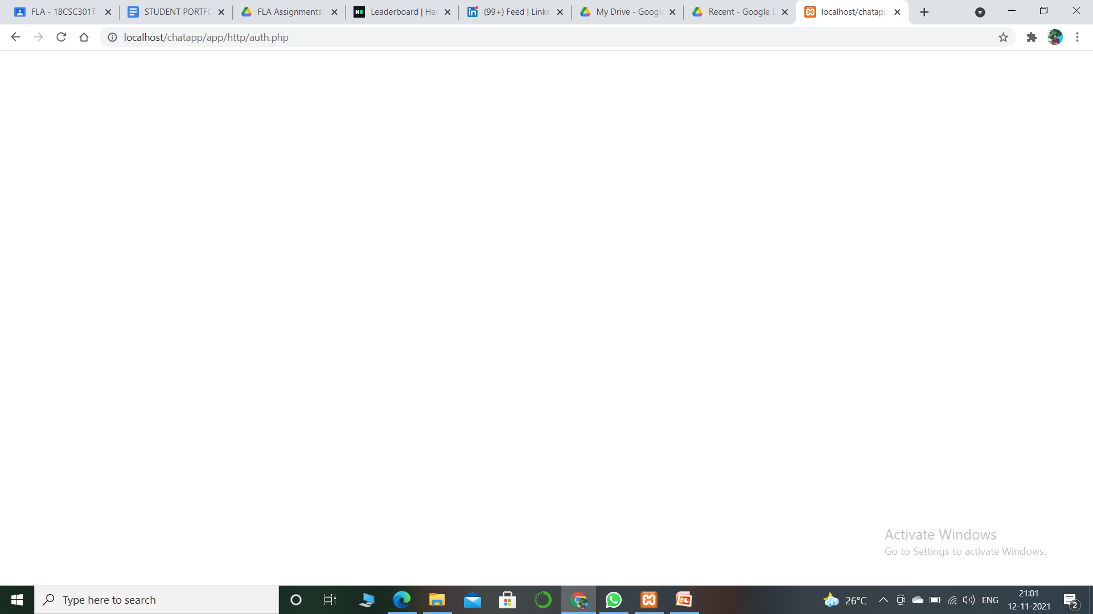
By giving wrong detailsit will be loading of a blank page.

Slide 21
Thanks
RA1911003010895

